Slide 1




NEXT GEN EMPLOYABILITY PROGRAM
Creating a future-ready workforce
Team Members
College Name
Student Name : S.Babitha
Student ID : au951221104007
JP College Of Engineering

Slide 2

CAPSTONE PROJECT SHOWCASE
Project Title
Voting Web Application using Django Framework
Abstract | Problem Statement | Project Overview | Proposed Solution | Technology Used | Modelling & Results | Conclusion

Slide 3
Abstract
This project presents the development of a sophisticated voting web application using the Django framework. The application aims to provide a user-friendly and secure platform for voters to participate in elections remotely. Key features include user authentication, encrypted ballot casting, real-time result tracking, and administrative functionalities for managing candidates and election settings. By leveraging Django's robust security measures and scalability, the platform ensures the integrity of the electoral process while promoting transparency and accessibility. This project contributes to the advancement of democratic practices by enabling greater engagement and participation in the electoral process through digital means.
Source :

Slide 4
Problem Statement
1. Accessibility Barrier: Traditional voting methods often pose significant accessibility challenges for individuals with disabilities, remote voters, or those unable to physically access polling stations. Addressing this issue requires designing a voting web application with intuitive user interfaces, compatibility with assistive technologies, and accessibilities. 2. Security Concerns: Paper-based voting systems are vulnerable to various security threats, including ballot tampering, voter impersonation, and hacking. Building a secure voting web application using the Django framework necessitates implementing robust encryption protocols, multi-factor authentication mechanisms, secure data transmission channels, and stringent access controls to safeguard against unauthorized access, manipulation, or interference, thereby fostering trust in the integrity of the electoral process. 3. Transparency and Auditability: Lack of transparency and auditability in traditional voting systems can undermine public trust in election outcomes. To address this challenge, the voting web application must provide transparent and verifiable processes for voter authentication, ballot casting, vote tallying, and result reporting
Source :

Slide 5
Project Overview
Create a new Django app within the project to handle the voting functionality. This app will contain models, views, templates, and any other necessary components.Define Django models to represent the data associated with the voting system, such as User, Poll, Choice, and Vote.
Project setup
App creation
Database models
Admin interfaces
User authentication
Poll creation
Voting and results display
Frondend design and URL routing
Testing and deployment

Slide 6
Proposed Solution
.
Utilize Django's built-in authentication system for user registration, login, and logout functionalities.
Customize authentication views and templates as needed.
Implement views and templates for displaying candidates and allowing users to cast their votes.
Ensure that each user can only vote once and handle any potential errors or edge cases.
Register models with Django's admin interface to allow administrators to manage candidates, voters, and votes easily.
Customize admin views and templates for better usability if necessary.
Source :

Slide 7
Advantages
Django's built-in features like authentication, URL routing, and templating system allow for quick development of complex web applications.
This project provides built-in security features like protection against SQL injection, cross-site scripting (XSS), cross-site request.
The programming language Django's ORM simplifies database interactions by abstracting away the need to write SQL queries directly, making database operations more intuitive and less error-prone.
Django is versatile .
Can be used to build a wide range of web applications, from simple blogs to complex e-commerce platforms, including voting systems
Source :

Slide 8
Disadvantages
Resource Intensive: Django’s comprehensive nature may lead to increased resource usage, particularly for smaller projects where the full range of features is not necessary. This could result in higher hosting costs or slower performance on low-resource servers.
Steep Learning Curve: For developers unfamiliar with Django or Python web development, there can be a significant learning curve. This may slow down the development process initially as developers need time to become proficient with the framework and its conventions.
Limited Real-time Updates: Django’s default architecture is not optimized for real-time updates or event-driven functionalities out of the box.
Source :

Slide 9




Technology Used
Front-end
Back-end
Source :

Slide 10
Modelling & Results
On developing a voting application using Django, meticulous attention is directed towards both modeling the underlying data structure and effectively presenting the voting results to users.
By Django's model system the application's data architecture is meticulously crafted, typically featuring models like Question and Choice to represent the polls and available choices.
Once users have participated in the voting process, conveying the results to them becomes paramount.
Django's templating system, the application dynamically generates HTML templates that vividly present the voting outcomes in an intuitive and visually engaging manner.
The application may utilize charting libraries or custom visualization techniques to elucidate the distribution of votes across different options, offering users valuable insights into the voting process's outcome.
Source :

Slide 11
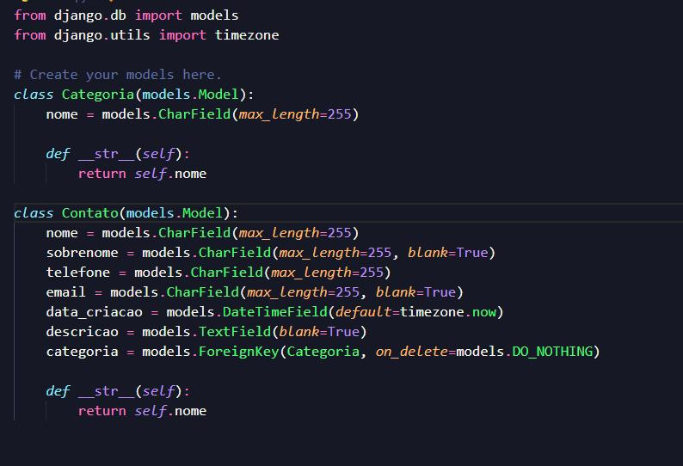
Homepage

Slide 12
About-Us-Page
1.Credibility: The "About Us" page establishes credibility by providing informationabout the organization's history, mission, and team members .
2.Mission and Values: It communicates the organization's mission, values, and objectivesin promoting democratic participation and decision-making.
3. Community Engagement: The page showcases the organization's commitment tocommunity engagement and empowerment through the voting process, inspiring active participation.
4. Contact Information: Users can easily reach out with questions, feedback, or inquiriesabout the voting application through the contact information provided on the page.

Slide 13
Service-Page
Header Section
Introduction section
User Services
Administrator Services
Organizational Services
Technical Services
Consulting Services
Call to Action Services

Slide 14
Departments-Page
Header Section
● Introduction Section
● Department Listings
● Department Details
● Key Personnel
● Collaboration Opportunities
● Footer Section

Slide 15
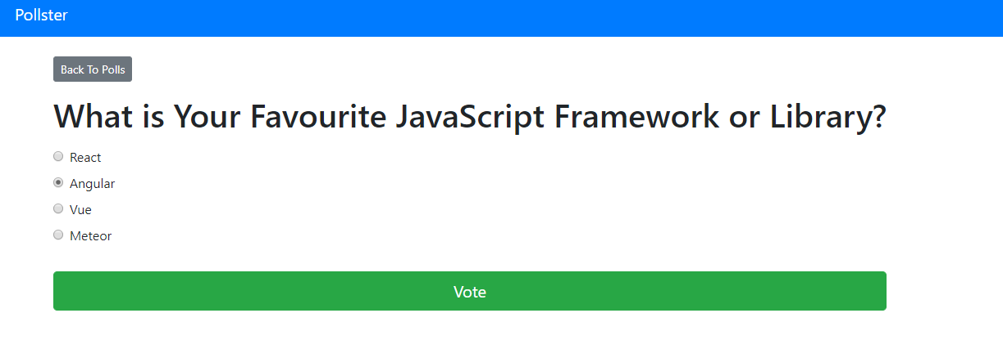
Blog-Page

Slide 16
Future Enhancements:
Utilize machine learning algorithms to analyze voting data, predict future trends, and provide personalized recommendations for users based on their voting history and preferences
Extend the voting application's reach by developing native mobile apps for iOS and Android platforms, offering a seamless and optimized experience for mobile users.
Explore integrating blockchain technology to enhance the transparency, security, and integrity of the voting process, ensuring that votes are immutable and tamper-proof.
Implement comprehensive reporting functionalities for administrators to generate detailed reports on voting patterns, demographics, and trends. This could include visualizations such as charts and graphs.

Slide 17
Conclusion
In conclusion, building a voting web application using the Django framework offers a solid foundation for creating a secure, scalable, and user-friendly platform. With Django's built-in features and extensive ecosystem of libraries and tools, developers can efficiently implement key functionalities such as user authentication, data modeling, and web templating. Overall, Django provides a robust framework for developing a voting web application that empowers users to participate in democratic processes effectively while ensuring the integrity and fairness of the voting process.
Source :

Slide 18
Thank You!
Notes:
Thank You !!

